Slide 1
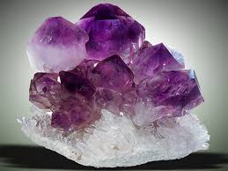
Phys 460 Describing and Classifying Crystal Lattices

Slide 2
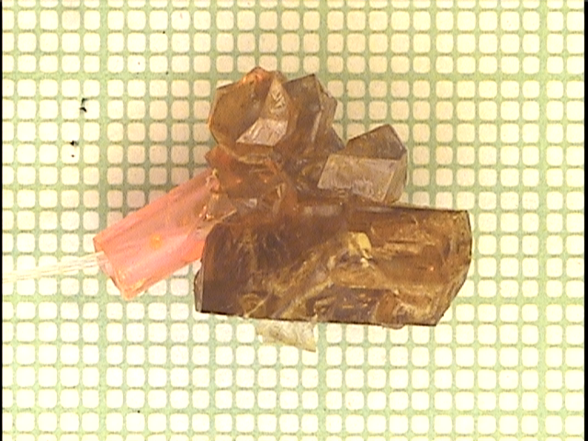
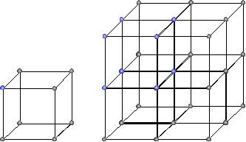
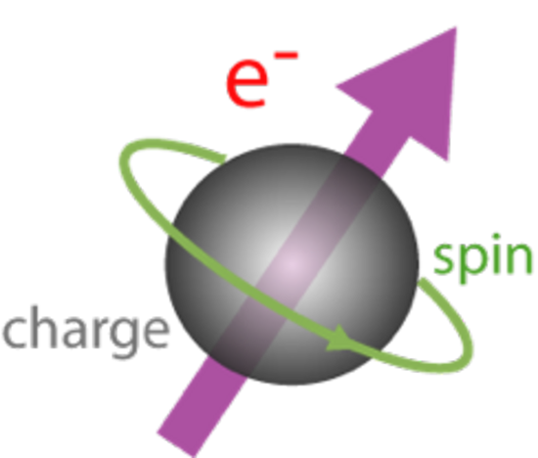
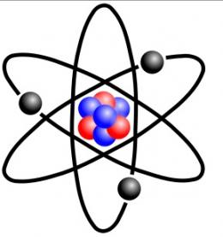
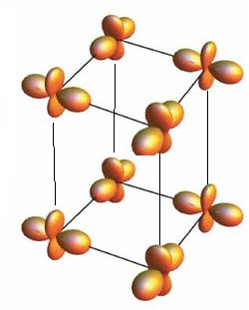
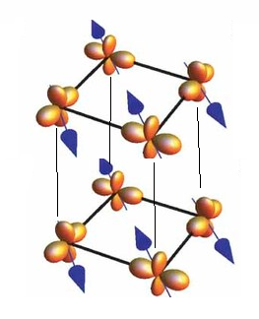
What is a “material”?
^
crystalline
Regular lattice of atoms
Each atom has a positively charged
nucleus surrounded by negative electrons
Electrons are “spinning”
→they act like tiny bar magnets!
Electrons don’t orbit like planets, but are distributed in space (“orbitals” or “Fermi sea”).
Neighboring spins and orbitals talk to each other and form patterns!

Slide 3
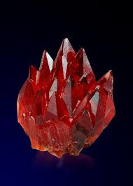
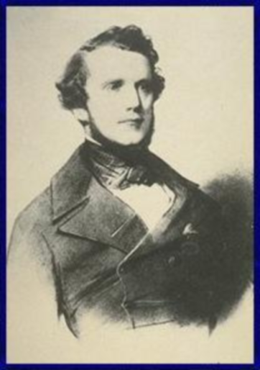
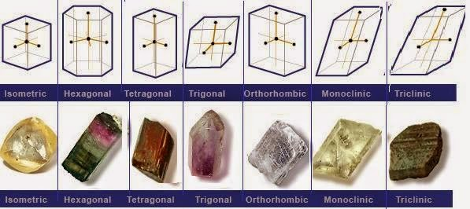
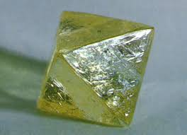
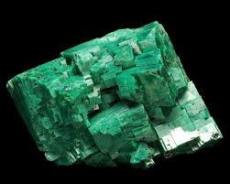
Crystallography- Origins in geology
Auguste Bravais
1811-1863
The atomic theory of atoms has long been proposed to explain sharp angles and flat planes (“facets”) of naturally occurring crystals.
Types of different crystal structures were categorized, and formed the foundation of the field of crystallography.
In 1848, French physicist (and crystallographer and applied mathematician) demonstrated that there were only 7 “types” of crystals, embodying 14 distinct “symmetries”.
This work was verified and greatly expanded upon in the 20th century with the advent of x-ray diffraction. (e.g. work W. Henry and W. Lawrence Bragg, 1913)

Slide 4
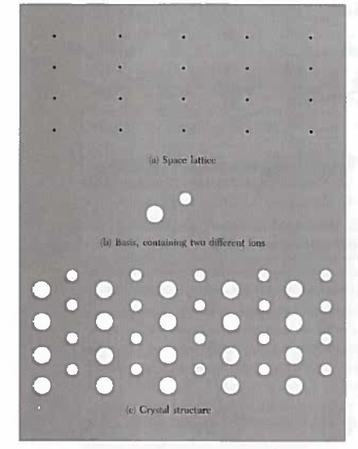
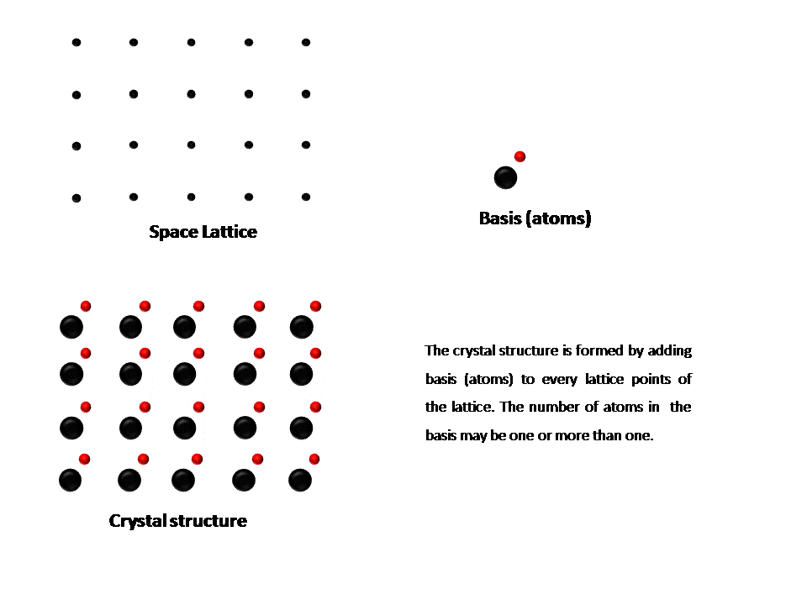
Crystals- a mathematical description
A crystal is defined to be a repeating, regular array of atoms.
A proper mathematical description must account for what is repeating and how it is repeating.
Two parts treated separately:
The fundamental repeating unit is
referred to as the basis.
How the basis repeats is specified by
Identifying the underlying lattice.
Crystal structure = lattice + basis
(or “Bravais lattice” + basis )
nano-physics.pbworks.com

Slide 5
Bravais lattice
A Bravais lattice (what Simon simply calls a “lattice”) is a mathematical construct, designed to describe the underlying periodicity of a crystal.
There are two completely equivalent definitions:
A Bravais lattice is a set of all points in space with position vectors, R, of the form
where a₁, a₂ and a₃ are any three independent vectors, and n_{i}∈Ζ.
A Bravais lattice is an infinite array of discrete points with an arrangement and orientation which looks exactly the same at each point.
NB- Definition 2 is handy for first impressions, but definition 1 will form the foundation for our mathematical treatment.
R = n₁a₁ + n₂a₂ + n₃a₃

Slide 6
Properties of a Bravais lattice
Seemingly general, there are actually a finite set of possible Bravais lattices (14 in 3D), determined by the underlying symmetries (more on this later).
Quick inspection shows that not every lattice is a Bravais lattice! A good counterexample is the common honeycomb:

Slide 7
Primitive vectors and unit cells
If one is looking at a Bravais lattice, it is possible to describe all points using the position vector R = n₁a₁ + n₂a₂ + n₃a₃. Here, the vectors a_{i} are known as primitive lattice vectors and the integers n_{i} are known as lattice indices.
In general, the repeating volume (area in 2D) in a crystal is known as the unit cell. For a Bravais lattice, the primitive lattice vectors span the smallest possible volume, and the resulting unit cell is called the primitive unit cell.
Neither primitive basis vectors nor the primitive unit cells are unique!

Slide 8
Properties of primitive unit cells
If every atom is described by R = n₁a₁ + n₂a₂ + n₃a₃, then one can show that every primitive cell has exactly one lattice point.
It follows that every primitive cell has exactly the same volume: v = 1/n, where n is point density.
One can always find a primitive cell by considering parallelepiped spanned by primitive basis vectors.
Another common choice is the Wigner-Seitz cell, created by bisecting the lines connecting a lattice point with its nearest neighbors.
Most symmetric cell, and volume closest to lattice point

Slide 9
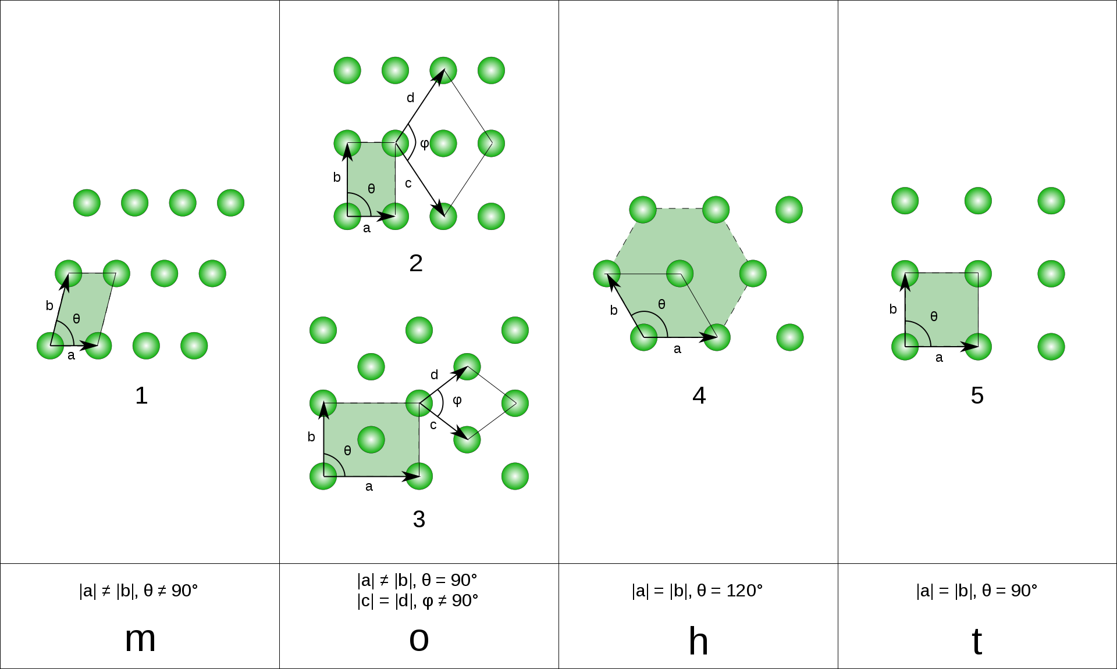
Bravais lattices in 2D
oblique
rectangular
hexagonal
cubic
centered rectangular

Slide 10
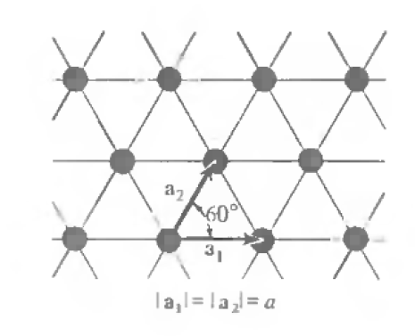
Example: the triangle lattice (a.k.a. the hexagonal lattice)

Slide 11
3D Example: the simple cubic lattice

Slide 12
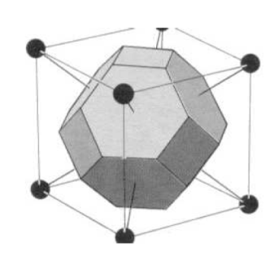
3D Example: the body-centered cubic (BCC)
OR

Slide 13
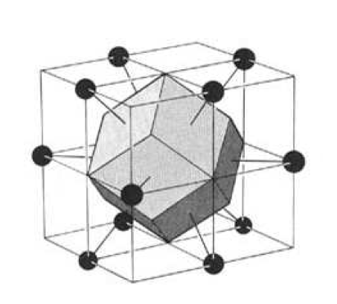
3D Example: the face-centered cubic (FCC)

Slide 15
Lattice with a basis
A Bravais lattice is a mathematical abstraction. To describe a real crystal lattice, one needs to dress the Bravais lattice with either a single atom, or a set of atoms. This repeating set of atoms is called the basis.
The vectors describing the positions of atoms in a basis, {r_{i}}, are called basis vectors, and are conventionally presented in terms of fractional steps along the lattice vectors.
This allows one to
Use the same Bravais lattice framework to
Describe non-Bravais lattices
To simplify discussion of complex Bravais lattice
through use of larger conventional unit cells, with
orthonormal lattice vectors
To describe crystals containing more than one
atom type.

Slide 16
Example: The honeycomb, using a basis
Though the honeycomb is clearly not a Bravais lattice, we can still describe it as a triangle lattice (which is Bravais) , using a two atom basis

Slide 17
Example: the BCC alttice, using a basis
The BCC lattice is Bravais, but the primitive lattice vectors are not perpendicular. It is often desirable to use a cubic Bravais lattice, with a two atom basis. The repeating (non-primitive) unit cell is known as the conventional unit cell.
Bravais lattice:
Basis:

Slide 18
Example: the FCC alttice, using a basis
The same conventional unit cell can be used to describe the FCC lattice, now with a 4 atom basis:
Bravais lattice:
Basis:

Slide 19
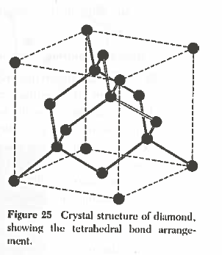
Example: The diamond lattice
Described as FCC lattice, with a 2-atom basis:
where a is the length of the conventional cubic cell.
Note: It is equally well described as an FCC with an
8 atom basis (FCC basis plus the same vectors
offset by [a/4,a/4,a/4]).

Slide 20
Sidebar: Coordination number
Each of the above three lattices is incredibly common, and characterize different classes of elements. What is the difference?
In many cases, the important difference is the number of nearest neighbors, which dictates how many bonds each atom has.
The number of nearest neighbor bonds for a given crystal lattice is called the coordination number, and usually denoted Z.
cubic, Z=6
BCC, Z=8
FCC, Z=12
diamond, Z=4

Slide 21
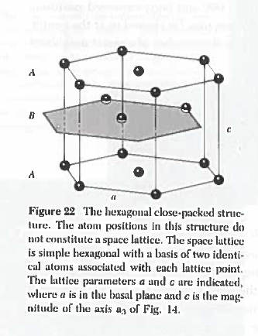
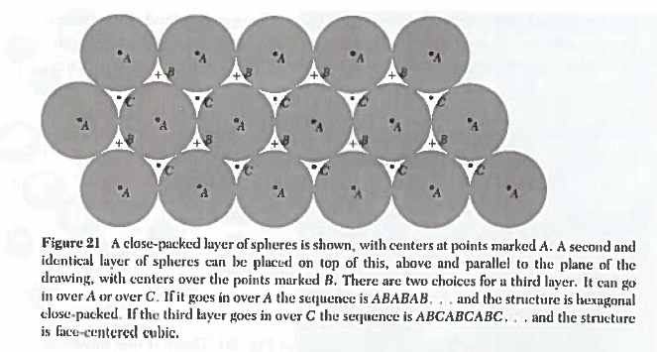
Example: hexagonal close packed (hcp)
Simple hexagonal lattice, with a 2 atom basis
Represents closest approach of a series of hard spheres.

Slide 22
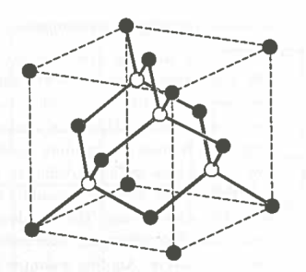
Common motifs in diatomic materials
Zinceblende (ZnS)
Zn
S

Slide 23
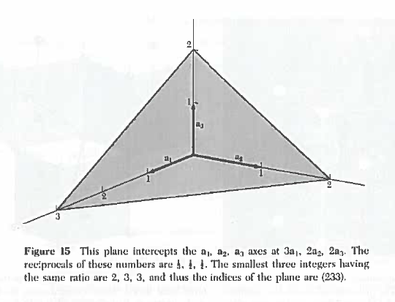
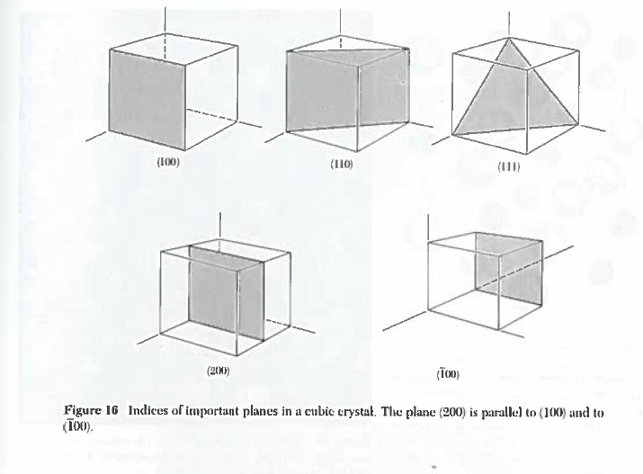
Sidebar: Indexing cubic directions and lattice planes
Steps:
Find intercepts of plane with primary axes .
Take inverse of intercepts.
Multiply by lowest number to make all values integers
Naming conventions:
(h,k,l) is the plane determined by procedure to the left
[h,k,l] is the vector normal to this plane.
{h,k,l} is the set of all symmetrically equivalent (h,k,l)

Slide 24
How do we classify lattices?
One of the successes of crystallography (and why we remember the name Bravais) is that it manages to sort the infinite number of potential lattices in nature into a finite number categories.
What category a lattice is in depends on the group of symmetry operators which can be applies which transforms a discrete set of coordinates (i.e. lattice points) into itself.
The above examples dealt primarily with translational symmetry operators, and one way of thinking about primary lattice vectors is the direction and distance once can shift every atom to recreate the sample lattice.
Additionally, there are a series of point symmetry operators that can be applied with an atom at the origin, which also bring the lattice into itself.
The collection of point symmetries obeyed by a crystal define its point group symmetries. If one includes translation operators and all compound operations, this collection of symmetries defines the space group of the lattice.

Slide 25
Point group symmetries
The point group symmetries are entirely captured by considering:
Rotations (2-,3-,4- and 6-fold) about any axis
Reflections across any plane
Inversion (r → -r) for all lattice points
For Bravais lattices (basis can’t break symmetry), it turns out there are only 7 distinct point groups: cubic, tetragonal, orthorhombic, monoclinic, triclinic, trigonal and hexagonal.
One can “derive” them by thinking about different ways of distorting a cube.

Slide 26
Space groups of Bravais lattices
Adding translation operators brings the total number of distinct symmetry groups to 14 for Bravais lattices in 3D
Relaxing spherical symmetry of the basis brings the number of groups to the much larger (but still finite) number of 230.
It is still common today amongst material physicist to refer a lattice’s point group symmetry as a starting point for discussion → these are worth knowing!

Slide 27
What’s next?
Now that have a mathematical handle on how to describe infinite lattices of atoms (and the associated jargon), we can move forward to discuss how this periodicity affects material properties. In the coming weeks, we will discuss:
Interaction of the lattice with light
Collective motion of atoms, and its effect on heat capacity
Motion of electrons in a periodic potential
Lattices of spins and magnetic order
For many (most) of these applications, it is more appropriate to talk about the discrete Fourier transform of the periodic lattice
→ i.e. we will use the reciprocal lattice, which will be the topic of next lecture

